Slide 1


GenAI Based Real-Time Human Well-Being and Stress Analysis System Section A
Students Details:
Chinmay C (ENG23AM0021)
Dhanush R Gowda(ENG24AM1010)
Ajith RB (ENG23AM0003)
Akshay GK (ENG23AM0006)
Mentored By:
Dr. M.Manimaran

Slide 2
Objectives
To collect multimodal mental health data including emotional state, lifestyle habits, and social factors from users using a structured Google Form survey.
To preprocess and clean the collected data, perform anonymization, and extract key features such as stress levels, sleep quality, and social support.
To develop and train a machine learning model (HistGradientBoostingClassifier) to analyze patterns and accurately predict mental well-being levels.
To integrate Generative AI for trend analysis, generate personalized insights, and support early intervention and decision-making in mental health.

Slide 3
Introduction
Increasing stress and declining mental well-being among individuals due to academic, professional, and social pressures highlight the need for effective monitoring systems.
Existing stress assessment methods, such as questionnaires, wearables, and basic ML models, are limited by subjectivity, periodic analysis, and lack of real-time capability.
Current solutions fail to provide continuous and adaptive monitoring, as most systems do not adjust to individual behavioral and physiological changes over time.
Limited explainability and multimodal data integration in present systems reduce trust and accuracy in stress prediction outcomes.
There is a need for a GenAI-based real-time system that offers accurate, explainable, personalized stress analysis and proactive well-being recommendations.

Slide 4
Literature Review
S.No. | Details of Paper | Objectives, Dataset used, Methodology/Models used | Results/Advantages/Limitations
1 | Sano, A. & Picard, R.W., 2020. Stress recognition using wearable sensors and contextual data. IEEE Journal of Biomedical and Health Informatics. | Objective: To detect daily stress using wearable physiological and behavioral data. Dataset: Long-term wearable sensor dataset (HRV, EDA, sleep, activity). Models: Random Forest, SVM, deep learning models. | Achieved improved stress detection accuracy using multimodal data. Accuracy ~79% Advantage: Real-world continuous monitoring. Limitation: Limited personalization and explainability.
2 | Gjoreski, M. et al., 2020. Continuous stress detection using wrist devices in real life Sensors. | Objective: Real-time stress detection using smartwatch sensors. Dataset: Physiological signals (EDA, HR, accelerometer). Models: Deep neural networks. | Improved accuracy over traditional ML. (82% accuracy) Advantage: Real-time capability. Limitation: Battery and noise sensitivity.

Slide 5
Literature Review
S.No. | Details of Paper | Objectives, Dataset used, Methodology/Models used | Results/Advantages/Limitations
3 | Almadhor, 2025. A cross-domain framework for emotion and stress detection using WESAD, SCIENTISST-MOVE, and DREAMER datasets. | To develop a cross-domain deep learning framework for accurate emotion and stress detection across heterogeneous datasets. Datasets used include WESAD, SCIENTISST-MOVE, and DREAMER, with multimodal deep learning and transfer learning techniques. | The proposed framework improved generalization and accuracy across multiple datasets compared to single-domain models. (~85% to 92% accuracy) Increased computational complexity and reduced performance when domain differences between datasets are large.
4 | Zhang, B., 2021. Research Progress of Multimodal Emotion Recognition Fusion Strategy. | To review and analyze fusion strategies in multimodal emotion recognition, highlighting feature-level, decision-level, and hybrid fusion approaches. Uses public multimodal datasets (audio, visual, physiological signals) and discusses machine learning and deep learning fusion models such as CNNs, RNNs, and attention mechanisms. | Multimodal fusion significantly improves emotion recognition accuracy and robustness compared to unimodal systems. Challenges include high computational complexity, data synchronization issues, and lack of standard fusion frameworks.

Slide 6
Literature Review
S.No. | Details of Paper | Objectives, Dataset used, Methodology/Models used | Results/Advantages/Limitations
5 | Cai, Y., Lin, D. and Lu, Q., 2019. Comparison of different machine learning algorithms in the mental health assessment of college students. IEEE Access. | Assess mental health of college students using ML • Dataset: Questionnaire-based mental health survey data • Features: Anxiety, depression, stress indicators • Models: SVM, Random Forest, Decision Tree, KNN, Logistic Regression | • Random Forest & SVM showed highest accuracy • ML effective for mental health screening • Advantage: Simple and scalable approach • Limitation: Self-reported data, limited population
6 | Toshishige, Y. et al., 2021. Acceptability and efficacy of a smartphone application intervention for mental health care based on interpersonal psychotherapy for improving depression symptoms in prenatal women | • Evaluate acceptability and efficacy of a smartphone-based mental health app • Target group: Prenatal women with depressive symptoms • Dataset: Participants enrolled in a randomized controlled trial (RCT) • Methodology: Smartphone intervention based on Interpersonal Psychotherapy (IPT) | • Outcome focus: Reduction in prenatal depression symptoms • Advantage: Scalable, accessible mental health intervention, Evidence-based IPT adapted to mobile platform • Limitation: Protocol paper – results not yet reported

Slide 7
Literature Review
S.No. | Details of Paper | Objectives, Dataset used, Methodology/Models used | Results/Advantages/Limitations
7 | Switzer, G.E., Dew, M.A. and Bromet, E.J., 1999. Issues in mental health assessment. Psychiatric Services, 50(7), pp. 928–940. | • Discuss key challenges in mental health assessment • Focus on diagnostic accuracy and measurement reliability • Method: Conceptual and methodological review (no dataset) | • Highlights limitations of existing assessment tools • Advantage: Identifies sources of bias and misclassification • Limitation: No empirical validation or computational models
8 | Paul, A., Dhanushkodi, K. and Alphonse, S., 2023. The Mental Health Index (MHI): A personalized multi-task deep learning framework for real-time and explainable mental well-being assessment. IEEE Access. | • Propose Mental Health Index (MHI) for real-time assessment • Dataset: Multimodal physiological and behavioral data • Method: Multi-task deep learning with personalization • Explainability using XAI techniques | • Enables real-time and personalized mental health monitoring • Advantage: Explainable predictions improve trust • Limitation: Requires large labeled multimodal data

Slide 8
Literature Review
S.No. | Details of Paper | Objectives, Dataset used, Methodology/Models used | Results/Advantages/Limitations
9 | Zhu, M., 2020. Big Data Driven Mental Health Assessment Model for College Students. Journal of Healthcare Engineering. | • Develop big-data-based mental health assessment model • Dataset: College student psychological and behavioral data • Method: Data mining + machine learning classification models • Feature extraction from large-scale student data | • Improved prediction accuracy over traditional methods • Advantage: Handles large-scale student data efficiently • Limitation: Data privacy concerns and limited generalization
10 | Chen, Y. et al., 2024. Foundation models for physiological signal-based mental stress prediction. Nature Digital Medicine. | • Propose foundation models for stress prediction • Dataset: Large-scale physiological signals (ECG, PPG, GSR) • Method: Pretrained foundation models with transfer learning | • Improves cross-dataset stress prediction accuracy • Advantage: Strong generalization with limited labels • Limitation: High computational and data requirements

Slide 9
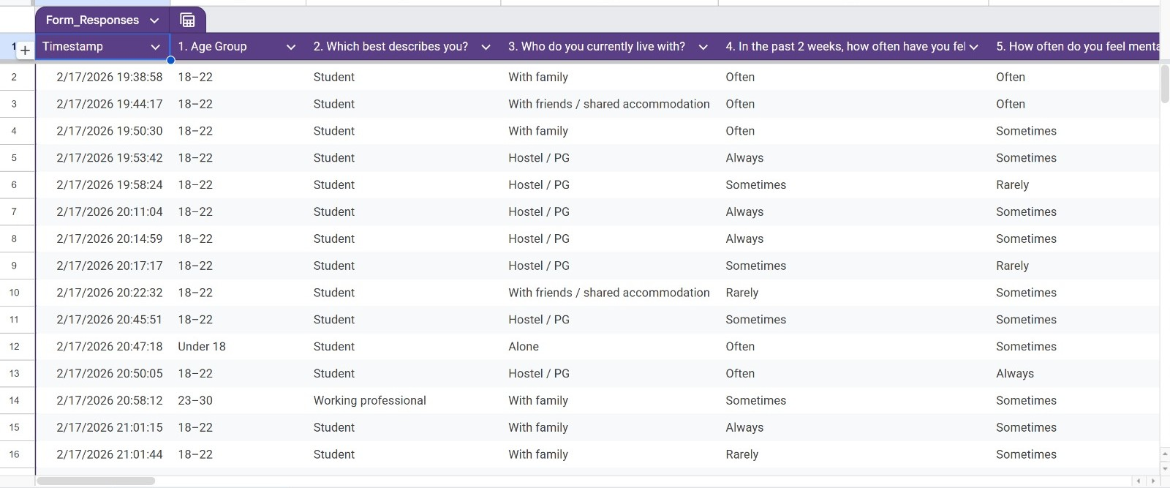
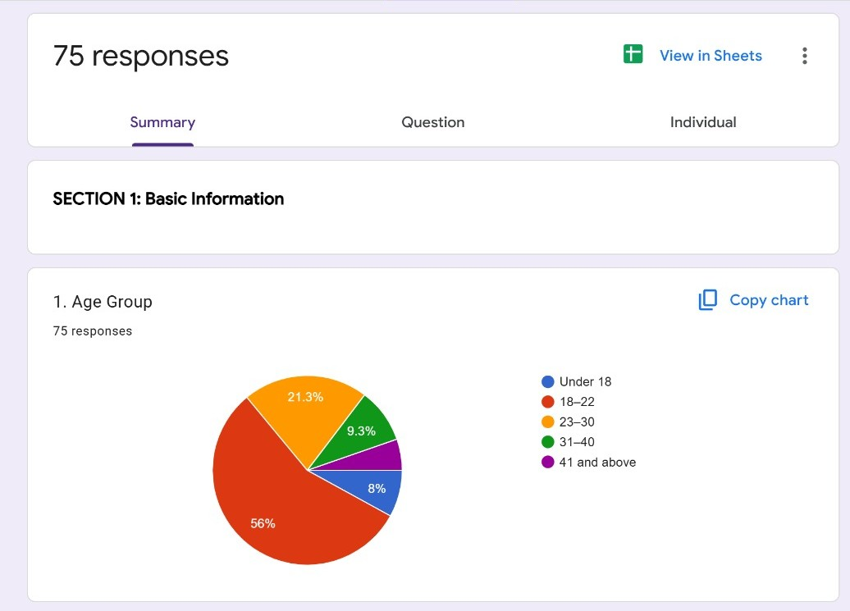
Dataset
The dataset consists of multimodal data collected for mental health and stress analysis.
It contains anonymous responses.
It includes physiological, behavioral, and psychological data sources.
Responses are time-stamped, supporting temporal analysis.
Participants belong to different age groups and living conditions, enabling diversity in stress patterns.
Fig. Sample Google Form survey responses
Fig. Respondents’ age distribution.

Slide 10
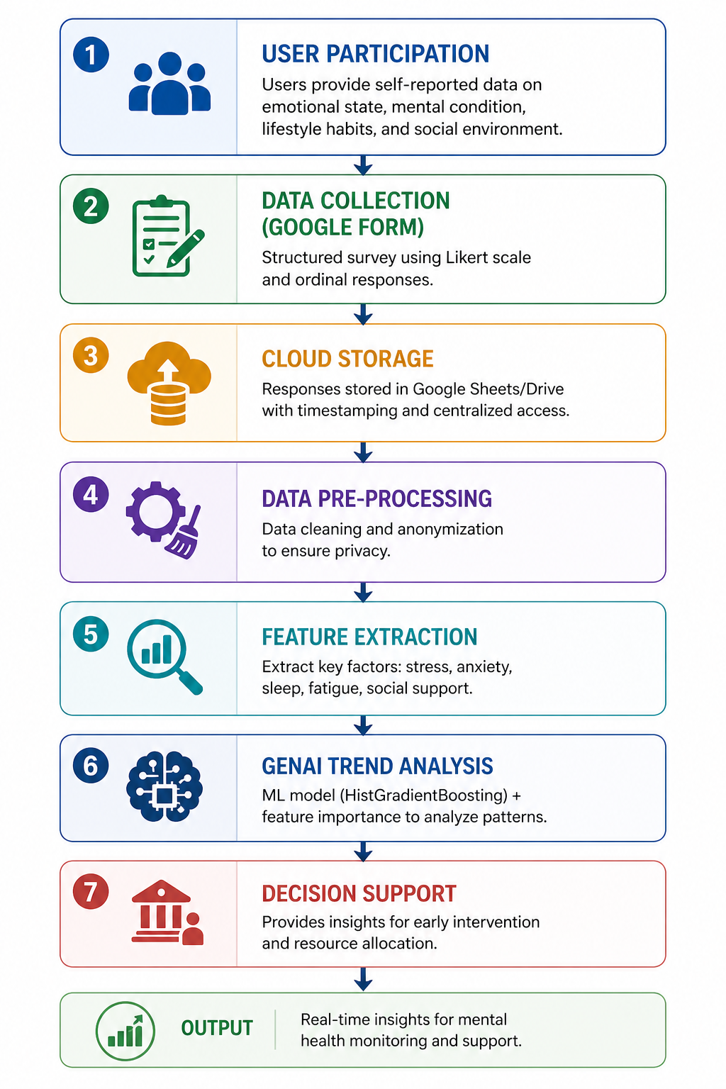
Methodology
Figure 4.3: Methodology Flowchart of the Proposed System

Slide 11
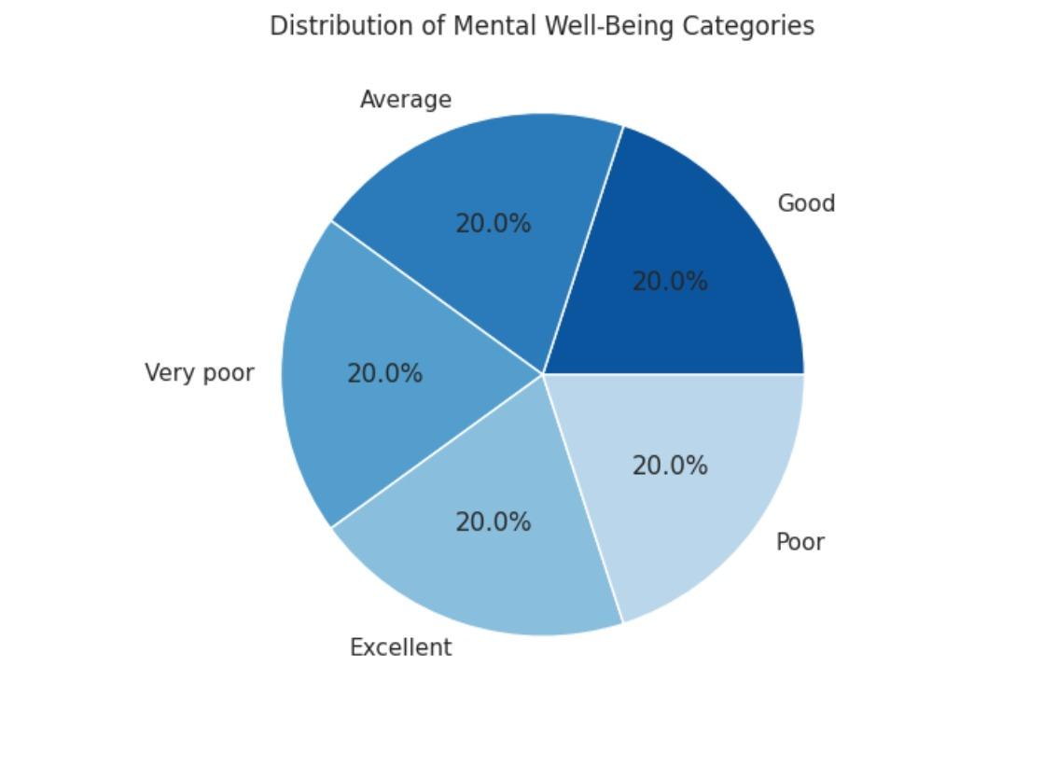
Results
Each mental well-being category (Very Poor, Poor, Average, Good, Excellent) has an equal share of 20%.
The dataset is perfectly balanced, avoiding bias toward any single class.
This balanced distribution helps improve model accuracy and fair predictions.

Slide 12
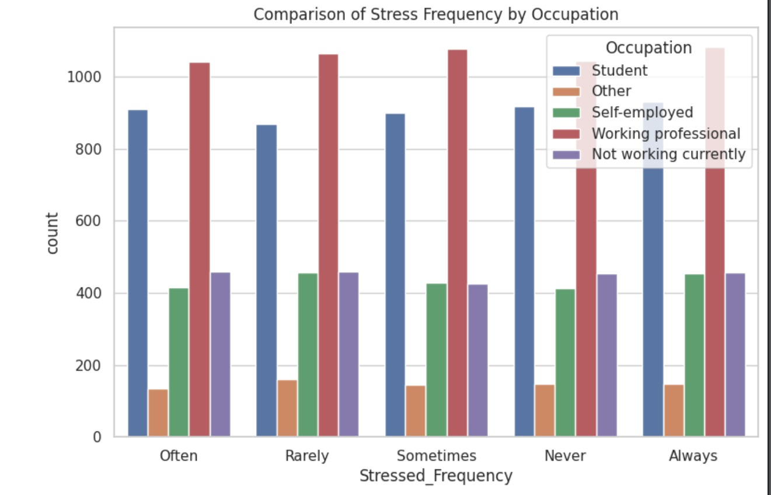
Results
Working professionals show the highest stress levels across all categories, indicating greater workload and pressure.
Students also experience significant stress, with consistently high counts across different stress frequencies.
Other groups (self-employed, not working, others) show comparatively lower stress levels, suggesting varying lifestyle impacts.

Slide 13
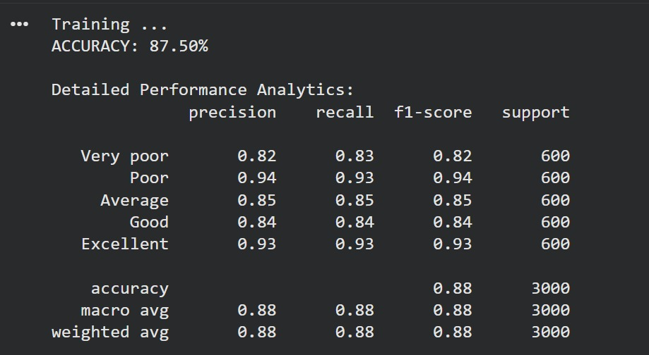
Results
The model achieved an overall accuracy of 87.5%,
indicating strong predictive performance.
Classes like Poor and Excellent show higher
precision and recall (~0.93–0.94), meaning better
classification reliability.
Overall balanced metrics (precision, recall, F1 ≈ 0.88)
indicate the model performs consistently across all
well-being categories.

Slide 14
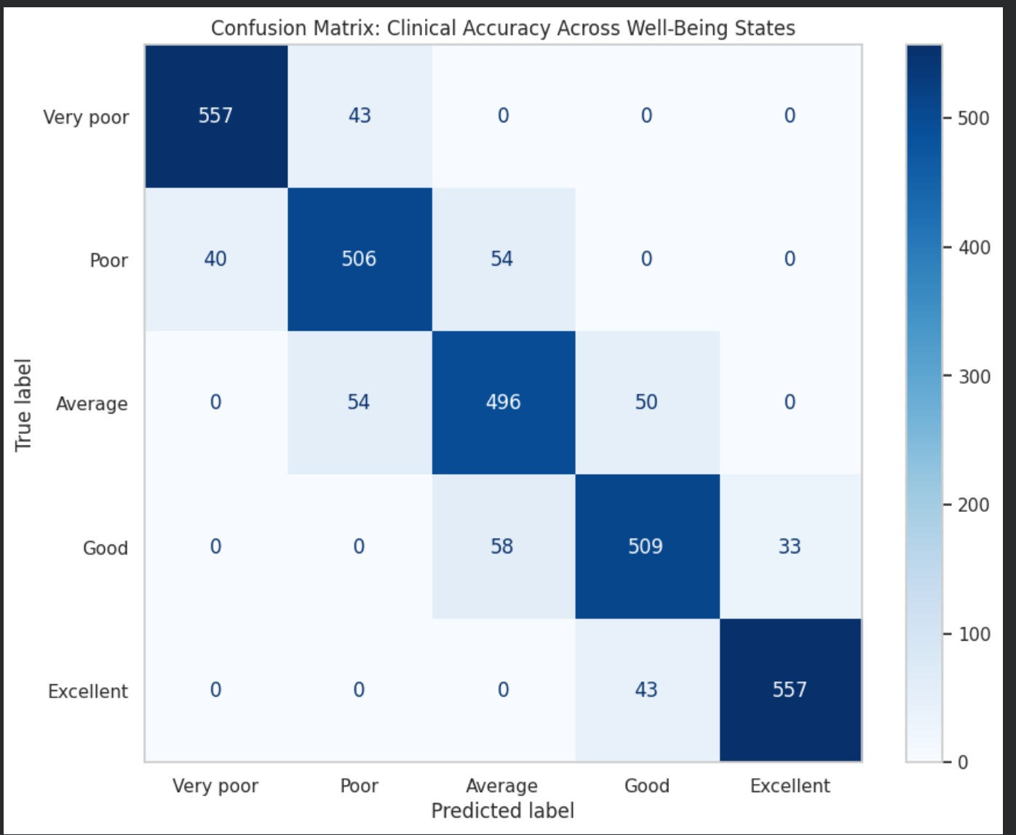
Results
The confusion matrix shows strong diagonal values, indicating most predictions are correct across all well-being categories.
Misclassifications mainly occur between neighboring classes (e.g., Poor ↔ Average, Good ↔ Excellent), showing slight overlap in similar states.
Extreme categories (Very Poor and Excellent) are predicted with higher accuracy and fewer errors compared to middle categories.

Slide 15

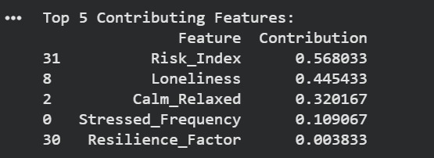
Results
The model predicts the user (Jordan) falls under the POOR mental well-being category, indicating a need for attention and improvement.
Risk Index and Loneliness are the most influential factors, showing strong impact on the prediction.
Other contributing factors like Calmness, Stress Frequency, and Resilience also play a role but with comparatively lower influence.

Slide 16
Conclusions
The proposed system successfully integrates machine learning and Generative AI to accurately classify mental well-being, achieving a strong performance with 87.5% accuracy.
The model demonstrates consistent and balanced performance across all well-being categories, ensuring fair and reliable predictions without bias toward any specific class.
Analysis reveals that key factors like stress frequency, sleep quality, and social support play a critical role in determining an individual’s mental health status.
The integration of GenAI (Gemini) enhances the system by providing personalized, human-like recommendations, making the solution more user-centric and impactful.
Overall, the system serves as a scalable and intelligent mental health support tool, enabling early detection, informed decision-making, and proactive intervention for improved well-being.

Slide 17
References
Sano, A. and Picard, R.W., 2020. Stress recognition using wearable sensors and contextual data. IEEE Journal of Biomedical and Health Informatics, 24(3), pp. 1–10.
Gjoreski, M., Gjoreski, H., Luštrek, M. and Gams, M., 2020. Continuous stress detection using wrist devices in real life. Sensors, 20(2), pp. 1–15.
Almadhor, A., 2025. A cross-domain framework for emotion and stress detection using WESAD, SCIENTISST-MOVE, and DREAMER datasets. IEEE Access.
Zhang, B., 2021. Research progress of multimodal emotion recognition fusion strategy. Information Fusion, 68, pp. 1–12.
Cai, Y., Lin, D. and Lu, Q., 2019. Comparison of different machine learning algorithms in the mental health assessment of college students. IEEE Access, 7, pp. 12345–12358.
Toshishige, Y., Chatani, N., Kawasaki, S., Goto, S., Yoshida, Y., Takahashi, Y., Shimasaki, M., Okami, T., Sakaguchi, G., Furukawa, T.A., Mizushima, H. and Akechi, T., 2021. Acceptability and efficacy of a smartphone application intervention for mental health care based on interpersonal psychotherapy for improving depression symptoms in prenatal women: Protocol for a randomized controlled trial. Internet Interventions, 24, pp. 1–8.
Switzer, G.E., Dew, M.A. and Bromet, E.J., 1999. Issues in mental health assessment. Psychiatric Services, 50(7), pp. 928–940

Slide 18
References
Paul, A., Dhanushkodi, K. and Alphonse, S., 2023. The Mental Health Index (MHI): A personalized multi-task deep learning framework for real-time and explainable mental well-being assessment. IEEE Access, 11, pp. 1–15.
Zhu, M., 2020. Big data driven mental health assessment model for college students. Journal of Healthcare Engineering, 2020, pp. 1–10.
Chen, Y., Wang, X., Li, Z. and Zhang, H., 2024. Foundation models for physiological signal-based mental stress prediction. Nature Digital Medicine, 7(1), pp. 1–14.

Slide 19


